Slide 1

Lecture 6 Array

Slide 2
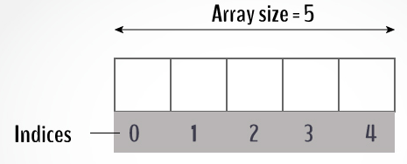
Array
A data structure, the array,
Stores a fixed-size
Sequential collection of elements
Of the same type
A sequence of values that are all of the same type.
If we have n values, we think of them as being numbered from 0 to n−1.

Slide 3
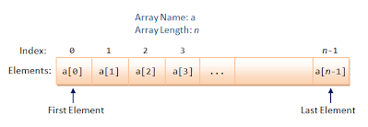
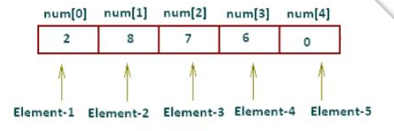
Representation of array

Slide 4
Creating Array Variables
dataType[] arrayName = new dataType[arraySize];
double[] myList = new double[5];
Initializing an array
dataType[] arrayName = {value0, value1, ..., value k};
double[] myList = {10,20,30,40,50};
10 | 20 | 30 | 40 | 50
myList[0] | myList[1] | myList[2] | myList[3] | myList[4]

Slide 5
Examples
float[] numbers = {10.5f , 6.7f , 8.9f };
String[] SUITS = { "Clubs", "Diamonds", "Hearts", "Spades" }
int[] numbers = {3 ,5 ,6 ,8};
char[] letters = {‘a’ , ‘s’ ,’d’ ,’f’, ‘g’, ‘h’, ‘j’, ‘k’, ‘l’};

Slide 6
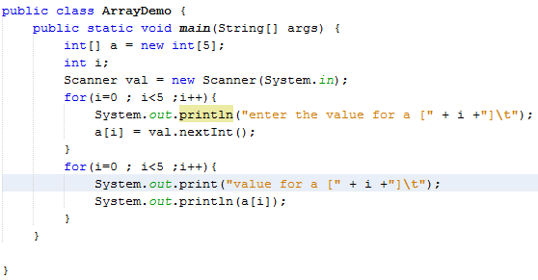
Processing Arrays

Slide 7
Array Class
java.util.Arrays
class contains various static methods for sorting and searching arrays, comparing arrays, and filling array elements.

Slide 8
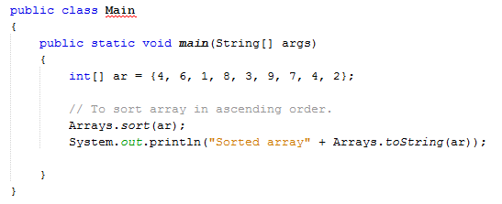
public static void sort(int[] a)
Sorts the specified array into ascending numerical order.

Slide 9
public static int binarySearch(int[] a, int key)
Returns an int value for the index of the specified key in the specified array.
Returns a negative number if the specified key is not found in the array.
For this method to work properly, the array must first be sorted by the sort method.

Slide 10
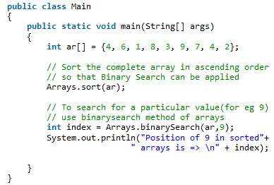

Example

Slide 11
Exercise
Set up an array to hold the following values, and in this order: 23, 6, 47, 35, 2, 14. Write a program to get the sum and average of all 6 numbers.
Using the above values, have your program print out the highest and lowest number in the array.

Slide 12
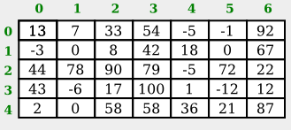
Multi-Dimensional Arrays in Java
In a two-dimensional, or "2D," array, the elements can be arranged in rows and columns.
for example, is a 2D array of int that has five rows and seven columns:

Slide 13

int[][] A = new int[3][4];
Assigning values

Slide 14
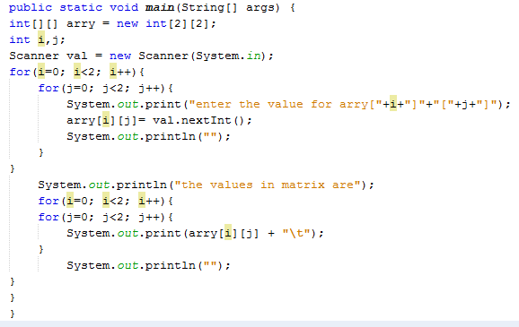
Example

Slide 15
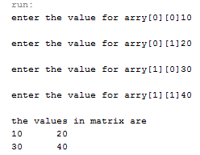
Output

Slide 16
Exercise
1. Perform addition of two 2D matrix.
Ask user to enter the values in matrix.
Equation for addition of two matrix is
C[i][j] = a[i][j] + b[i][j];
e.g. a[2][2] = { {10,20},{30,40}}
b[2][2]= { {50,60}, {70,80}}
C[2][2] = { {60, 80} , {100,120}}

Slide 17
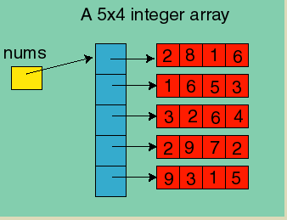
A 2-D Array is really an Array of Arrays

Slide 18
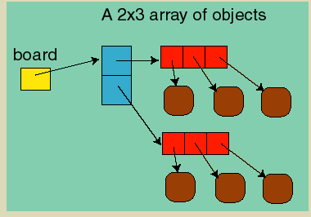
Internally, Java stores 2 dimensional arrays as an array of arrays:

Slide 19
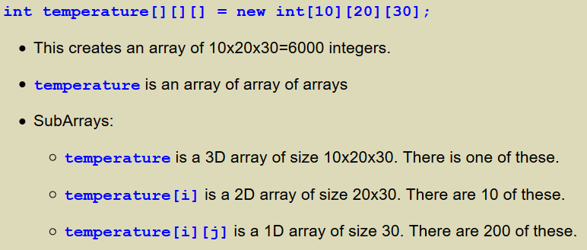
Higher Dimensional Arrays
One can create arrays of higher dimension than 2. For example, if we were measuring the temperature in a rectangular volume.

